Slide 1

Layout and Widget part 2
Emerging Technology : Flutter
Week 4
Program Studi Teknik Informatika
Fakultas Teknik – Universitas Surabaya

Slide 2

LIST VIEW
01

Slide 3

List View
A commonly-used scrolling widget to display multiple items (as children)
To construct a ListView:
Use the default constructor, passing a List<Widget> as its children
  This constructor is appropriate for a small list of items
  Constructing the List requires working on each item, even if they may not initially appear on screen
Use ListView.builder() constructor for larger (or infinite) number of items
  The builder is called only for items that are visible on screen

Slide 4
Preparation
Let’s show several food recipes in list of cards that consist of the food name, its photo, and its recipe.
The data are in form of array of objects. Later, after learning about database and web service, we’ll move this data into database.
Add class declaration on basket.dart outside of any classes:
class Recipe {
int id;
String name;
String photo;
String desc;
Recipe({required this.id, required this.name,required this.photo,
required this.desc});
}
required means this field may not be null.
If it is not required, either provide default value or make it nullable

Slide 5
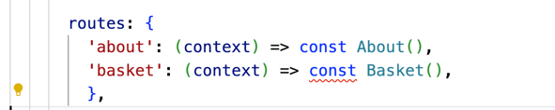
Sample data
Put the recipes var as a member of Basket class.
To add the data, you may create/change the constructor. And remove const in route
var recipes = <Recipe>[];
Basket({super.key})
{
recipes.add( Recipe(
id: 1,
name: 'Rujak Cingur',
photo: 'https://www.astronauts.id/blog/wp-content/uploads/2023/12/rujak-cingur-makanan-khas-daerah-jawa-timur.jpg',
desc: 'Rujak Cingur, makanan khas Surabaya, menjadi unik dengan menggunakan cingur (mulut sapi) sebagai bahan utama.',
),
);
recipes.add( Recipe(
id: 2,
name: 'Nasi Gudeg',
photo: 'https://www.astronauts.id/blog/wp-content/uploads/2023/12/nasi-gudeg-makanan-khas-daerah-DI-Jogjakarta.jpg',
desc: 'Nasi Gudeg, kuliner khas Jogja, merupakan olahan nangka muda yang dimasak dengan santan.',
),
);
recipes.add( Recipe(
id: 3,
name: 'Palumara',
photo: 'https://www.astronauts.id/blog/wp-content/uploads/2023/12/palumara-makanan-khas-daerah-sulawesi-tengah.jpg',
desc: 'Palumara, sup ikan khas Sulawesi Tengah, adalah perpaduan citarasa pedas dan asam yang menggoda selera.',
),
);
}

Slide 6
List widget function
Put this function inside the Basket class
List<Widget> widRecipes() {
List<Widget> temp = [];
int i = 0;
while (i < recipes.length) {
Widget w = Card(child: Text(recipes[i].name));
temp.add(w);
i++;
}
return temp;
}
We just display the name of the recipe first. Next after it can be shown in the ListView, we will fix it by adding photo and description

Slide 7
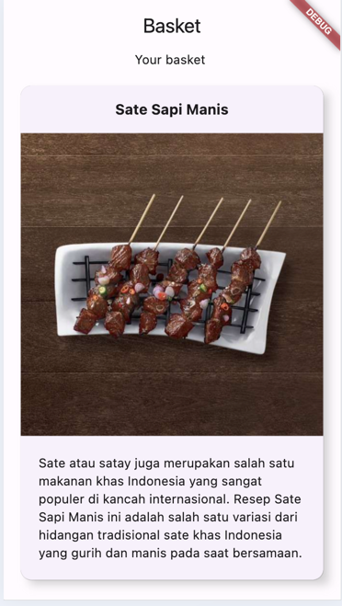
The ListView
body: SingleChildScrollView(
child: Column(children: [
Text("Your basket "),
ListView(
shrinkWrap: true,
physics: NeverScrollableScrollPhysics(),
children: widRecipes(),
),
Divider(
height: 100,
)
])
),
Modify the widRecipes() function so it can produce better appearance, like shown here :

Slide 8
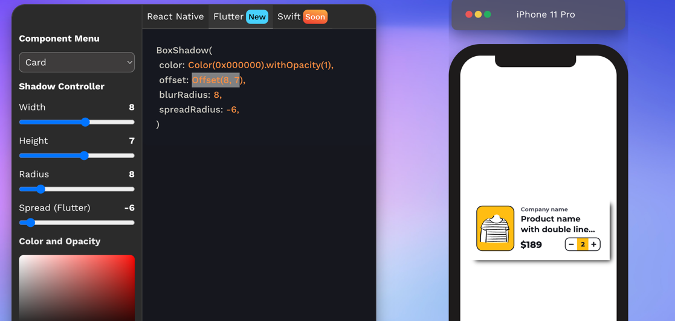
ShadowGenerator
A helpful website for generating box shadow properties can be found at:
https://shadow-generator-mobile.vercel.app/#editor

Slide 9
Answers
child:
Card(
child: Column(
children: [
Container (
margin: const EdgeInsets.all(15),
child: Text(
recipes[i].name,
style: const TextStyle(fontSize: 16,fontWeight: FontWeight.bold),
)
),
Image.network(recipes[i].photo),
Container (
margin: const EdgeInsets.all(20),
child: Text(recipes[i].desc),
)
]
)
)
);
temp.add(w);
i++;
}
return temp;
}
List<Widget> widRecipes() {
List<Widget> temp = [];
int i = 0;
while (i < recipes.length) {
Widget w = Container(
margin:const EdgeInsets.all(15),
decoration: BoxDecoration(
boxShadow: [
BoxShadow(
color: Color.fromRGBO(128, 128, 128, 0.5),
spreadRadius: -6,
blurRadius: 8,
offset: const Offset(8, 7),
),
]
),

Slide 10
TEXTFIELD
02

Slide 11
TextField
A Material Design text field
The onChanged callback is called when the text is changed
When the user indicates they are done typing (e.g., by pressing checkmark button on the virtual keyboard), onSubmitted callback is called
A controller is used to control the text to display in the text field
  For example, to set the initial text, use a controller that already contains some text
  It may also control the selection and composing region, as well as observe changes to the text, selection, and composing region
The decoration property controls the decoration (by default, a divider line below the text field), e.g. adding a label or an icon
  Set to null and the decoration (including any extra padding for saving space for the label) will be removed

Slide 12
Re-arrange recipe
We will continue the previous topic about food recipe.
Because the recipe class and variable will be used in more than one screen, and to make it well organized, we will put recipe class and recipe variable in new file and in new folder (inside lib folder) : \class\recipe.dart
We must import above file in the basket.dart.
import '../class/recipe.dart';

Slide 13
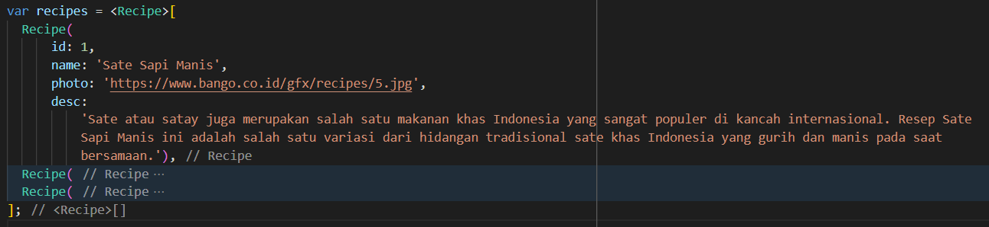
recipe.dart reorganized
Instead of adding items after declaring the list, you can also create the Recipe objects directly like this:
Declare this var recipes inside the recipe.dart

Slide 14
New screen. addrecipe.dart. Stateful.
For the next widget in following slide, we will use a stateful type of screen.
import 'package:flutter/material.dart';
class AddRecipe extends StatefulWidget {
const AddRecipe({super.key});
@override
State<StatefulWidget> createState() {
return _AddRecipeState();
}
}
class _AddRecipeState extends State<AddRecipe> {
@override
Widget build(BuildContext context) {
return Scaffold(
appBar: AppBar(
title: const Text('Add Recipe'),
),
body: const Center(
child: Text('Example Text'),
),
);
}
}
Add a menu in the drawer that call this screen

Slide 15
Add Text field with controller
If we want to set or get value in the text field easily, we can connect text field with a controller.
final TextEditingController _recipeNameController = TextEditingController();
@override
void initState() {
super.initState();
_recipeNameController.text = "your food name";
}
------
TextField(
controller:_recipeNameController,
onChanged: (v) {
print(_recipeNameController.text);
print(v);
},
),
initState is used for initializing value of variables. It will be run first and just once. Add this within _AddRecipeState class.
Build function will be executed in the setState.
Print function will create text in console. Usually used for debugging.

Slide 16
onChanged and setState
Now we try using onChanged and followed with setState to modify the property of another control.
We will add new TextField for storing recipe description, we allow user to input until 200 characters. We provide a text showing the number of character left that can still added in the TextField recipe description.
Add another controller.
final TextEditingController _recipeDescController = TextEditingController();
@override
void initState() {
super.initState();
---
_recipeDescController.text = "Recipe of ..";
}

Slide 17
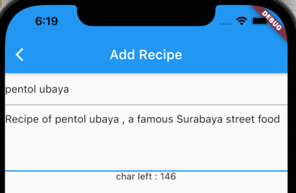
onChanged and setState
Add TextField
TextField(
controller: _recipeDescController,
onChanged: (v) {},
keyboardType: TextInputType.multiline,
minLines: 4,
maxLines: null,
)
Add variable to store char number left.
Initiate with 200-character in the description textfield
int _charleft=0;
initState()….
_charleft = 200 - _recipeDescController.text.length;
Add onChanged that update the _charleft variabel and calling setState
onChanged: (v) {
setState(() {
_charleft = 200 - v.length;
});
},
Add Text for showing char number left .
Text("char left : $_charleft")

Slide 18
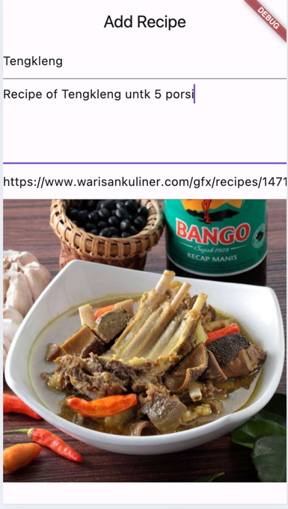
onSubmitted and setState
onSubmitted is raised when user finishes texting and push Enter or Return keys. Add new TextField for storing photo URL of the recipe. Also add an Image widget to open the URL of the recipe. (don’t forget to setup the controller)
TextField(
controller: _recipePhotoController,
onSubmitted: (v) {
setState(() {});
},
),
Image.network(_recipePhotoController.text)
press enter key after fill-in url to refresh the image
If you encounter overflow problem while rendering the page, don’t forget to apply SingleChildScrollView

Slide 19
BUTTONS
03

Slide 20
Buttons
Three types: TextButton, ElevatedButton, and OutlinedButton
Each new button class has its own theme: TextButtonTheme, ElevatedButtonTheme, and OutlinedButtonTheme
The appearance of buttons is specified by a ButtonStyle object
  The button themes are also configured with a ButtonStyle object
  A ButtonStyle is itself just a collection of visual properties
  Many of these properties are defined with MaterialStateProperty, which means that their value can depend on the button’s state

Slide 21
ButtonStyle
alignment → AlignmentGeometry?
The alignment of the button's child.
backgroundColor → MaterialStateProperty<Color?>?
The button's background fill color.
elevation → MaterialStateProperty<double?>?
The elevation of the button's Material.
fixedSize → MaterialStateProperty<Size?>?
The button's size.
foregroundColor → MaterialStateProperty<Color?>?
The color for the button's Text and Icon widget descendants.
mouseCursor → MaterialStateProperty<MouseCursor?>?
The cursor for a mouse pointer when it enters or is hovering over this button
overlayColor → MaterialStateProperty<Color?>?
The highlight color that's typically used to indicate that the button is focused, hovered, or pressed.
padding → MaterialStateProperty<EdgeInsetsGeometry?>?
The padding between the button's boundary and its child.
shadowColor → MaterialStateProperty<Color?>?
The shadow color of the button's Material.
shape → MaterialStateProperty<OutlinedBorder?>?
The shape of the button's underlying Material.
side → MaterialStateProperty<BorderSide?>?
The color and weight of the button's outline.
textStyle → MaterialStateProperty<TextStyle?>?
The style for a button's Text widget descendants.
For more information, please refer to https://api.flutter.dev/flutter/material/ButtonStyle/ButtonStyle.html

Slide 22
WidgetStateProperty
Each UI widget may have their own states, e.g. focused, hovered, pressed, disabled → expressed as WidgetState
WidgetStateProperty helps us return a proper property (e.g., color, font size, etc.) according to the current state
ButtonStyle has many widget state properties to configure the appearance of buttons
To resolve a property depending on combinations of WidgetStates, use the helper function WidgetStateProperty.resolveWith(), passing a function as its argument
  You can also use a lambda to pass as argument

Slide 23
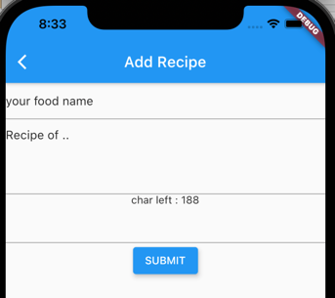
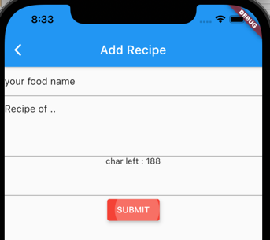
Example
Add a color function.
Color getButtonColor(Set<WidgetState> states) {
if (states.contains(WidgetState.pressed)) {
return Colors.red;
} else {
return Colors.blue;
}
}
Add button
ElevatedButton(
style: ButtonStyle(
elevation: WidgetStatePropertyAll(5),
backgroundColor:
WidgetStateProperty.resolveWith(getButtonColor),
),
onPressed: () {},
child: const Text('SUBMIT'))

Slide 24
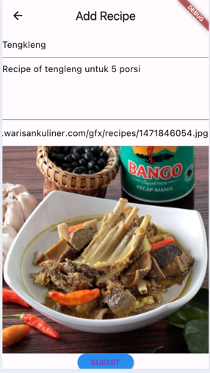
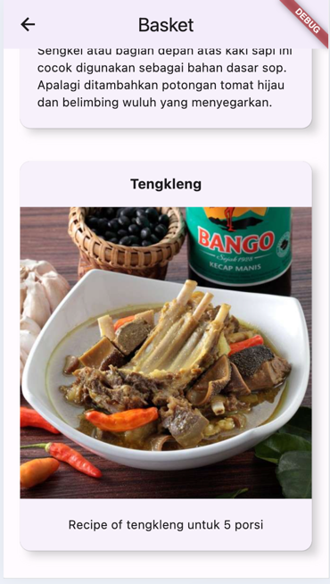
Add recipe
Add on pressed.
onPressed: () {
recipes.add(Recipe(
id: recipes.length + 1,
name: _recipeNameController.text,
desc: _recipeDescController.text,
photo: _recipePhotoController.text,
));
},
When we click add, it is silently adding data to recipe list, user doesn’t get any feedback. We will examine it later.

Slide 25
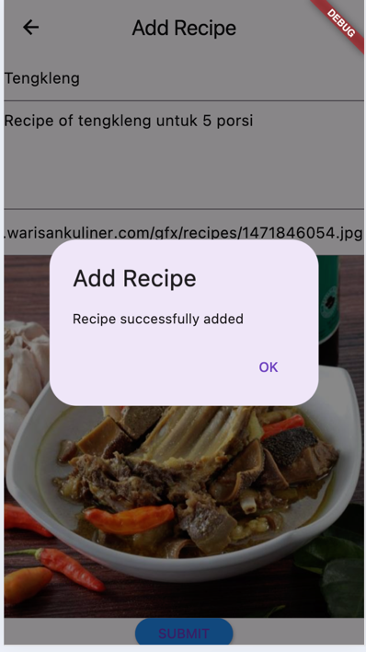
Adding Alert Dialog
showDialog<String>(
context: context,
builder: (BuildContext context) => AlertDialog(
title: Text('Add Recipe'),
content: Text('Recipe successfully added'),
actions: <Widget>[
TextButton(
onPressed: () => Navigator.pop(context, 'OK'),
child: const Text('OK'),
),
],
));
Add this code inside the onPressed after adding the recipe

Slide 26
Button with Icon
Button can be equipped with icon by using .icon constructor.
ElevatedButton.icon({Key? key,
required VoidCallback? onPressed,
VoidCallback? onLongPress,
ButtonStyle? style,
FocusNode? focusNode,
bool? autofocus,
Clip? clipBehavior,
required Widget icon,
required Widget label}
)

Slide 27
DROPDOWN BUTTON
04

Slide 28
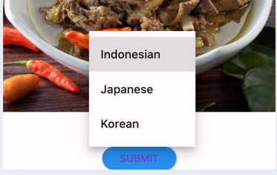
DropDownButton
String _recipeCategory = "Indonesian";
-----
DropdownButton(
items: const [
DropdownMenuItem(
value: "Indonesian",
child: Text("Indonesian"),
),
DropdownMenuItem(
value: "Japanese",
child: Text("Japanese"),
),
DropdownMenuItem(
value: "Korean",
child: Text("Korean"),
),
],
value: _recipeCategory,
onChanged: (value) {
setState(() {
_recipeCategory = value!;
});
},
),
DropDownButton is used when user must pick one from given options.

Slide 29
EXERCISE
05

Slide 30
Class Activity
Modify the recipe class structure, the card, and the add recipe code so the recipe can have category (Indonesian, Japanese, Korean)
and Spicy or not Spicy.
Modify also your Basket page. Add category and
spicy icon (if your menu is spicy).
Example of using Checkbox
Row(children: [
Checkbox(
checkColor: Colors.white,
value: _isSpicy,
onChanged: (bool? value) {
setState(() {
_isSpicy = value!;
});
},
),
const Text("Spicy")
]),

Slide 31



